Slide 1
Adapting Gradle for the CERN Accelerator Control System
Endre Fejes
BE-CO-APS Development Tools team
Vito Baggiolini, Niall Stapley, Natalia Yastrebova, Lajos Cseppentő, Zsolt Kővári

Slide 2
Overview
CERN Environment
Migration to Gradle
How Gradle helped
How Gradle could have helped more

Slide 3
CERN Beams Controls environment

Slide 4
CERN environment
https://cds.cern.ch/record/2020780

Slide 5
Our users
~100 Professional software developers
Working on frameworks, libraries, and servers
~80 Domain experts: physicists, operators
Irreplaceable domain knowledge
Know what is needed – want to contribute
Limited software experience
“Just has to work”

Slide 6
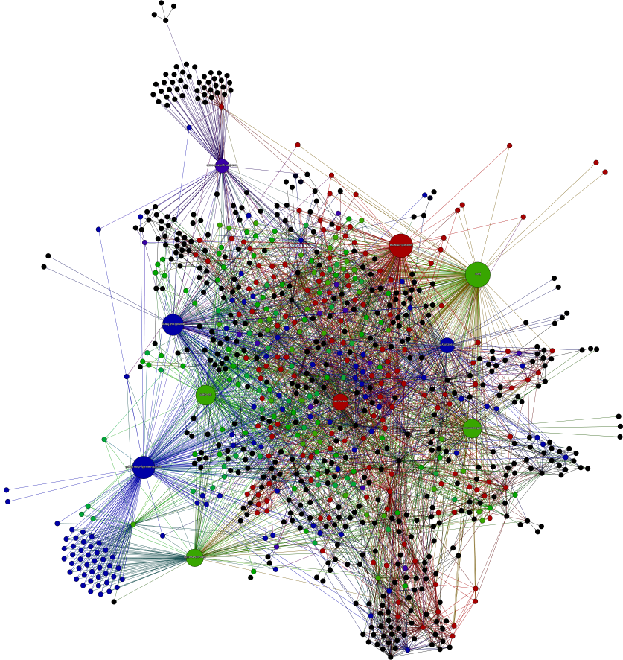
Our systems - scale
Image by Olivier Da Silva Alves
10+ MLOC of Java
1000+ projects
20+ level deep dependency hierarchy

Slide 7

Our systems - limitations
We’re not Facebook / Google
All component has to work: no degraded operation
Limited testing – there is no test LHC, no canaries
Stability, reliability over cutting edge
- not ignoring new technologies though
Enable physicists to do physics

Slide 8

Development tools team
Provide tooling for Java community
Make development simple and convenient
Make everything traceable

Slide 9
Migration overview

Slide 10

Old build-system
~15 years old, ant-based build system
Did not scale – designed for couple dozen projects
Dependency resolution by Apache JJar
Patched over and over again
Lack of support: plugins, community
DISCONTINUED

Slide 11
Migration requirements
Smooth transition - seamless migration
Without restructuring / refactoring all projects
Intuitive – with minimal training
With minimum support overhead
Changing the build system, not the users

Slide 12
Build tool timeline
1998 – Work on new Java Control System started
2002 – Old, ant-based build tool introduced
2011 – Maven pilot
2013 – Gradle adaptation pilot
2015 – Few projects migrated as test
2017 Q1 – Core projects migrated (~50%)
2017 Q2 – 95% of projects migrated

Slide 13
How Gradle helped the migration

Slide 14
Flexible versioning
Dynamic, programmatic version
def suffix = new Date().format("...", tz) project.version += suffix > test-1.0.0-20170527-093000.jar
Can be on-demand
if (project.hasProperty('timestamp')) { ... }

Slide 15
Task generation
Example: creating multiple jar variants per project
app
├── build.gradle
├── config-2tier/config.properties
├── config-3tier/config.properties
└── src/main/java/com/example/app/Hello.java

Slide 16

Tasks example – expectation
META-INF/MANIFEST.MF
Manifest-Version: 1.0
Variant: 2tier
Jars to generate:
app/build/libs
├── app-2tier-1.0.0.jar
└── app-3tier-1.0.0.jar
config.properties
variant=2tier
config.properties
variant=3tier
META-INF/MANIFEST.MF
Manifest-Version: 1.0
Variant: 3tier

Slide 17
Example: generated jar tasks
apply plugin: 'java'
['2tier', '3tier'].each { variant ->
def jarTask = task("jar_${variant}", type: Jar) {
from fileTree("config-${variant}")
baseName = "${project.name}-${variant}"
manifest.attributes(Variant: variant)
}
}

Slide 18
Task generation in general
Same task type for a dynamic collection of items
(Create multiple jars)
Up-to-date status per item
(Only generate outdated / missing jars)
Task type that can not operate on 1 item per task
(Jar task type: one jar per task)

Slide 19

POM customisation
task upload(type: Upload) {
repositories.mavenDeployer {
pom.project {
groupId 'com.example'
artifactId 'app'
version '1.0.0'
scm {}
properties {}
dependencies {}
// ...
<?xml ...>
<project ...>
<modelVersion>4.0.0</modelVersion>
<groupId>com.example</groupId>
<artifactId>app</artifactId>
<version>1.0.0</version>
<scm><url>...</url></scm>
<properties>...</properties>
<dependencies>...</dependencies>

Slide 20
POM – extra properties
For audit and support, i.e. traceability
def propertyMap = [
'buildBy': System.getProperty('user.name'),
'buildJdk': System.getProperty('java.version')
'buildTime': new Date().format("yyyy-MM-dd'T'HH:mm:ssZ")
'buildAgent': "gradle-${gradle.gradleVersion}".toString(),
'buildHost': InetAddress.localHost.hostName,
'buildAddress': InetAddress.localHost.hostAddress,
]
pom.project { properties propertyMap }

Slide 21
POM – extra dependencies
Custom dependencies, versions
pom.project {
dependencies {
dependency {
groupId "com.example"
artifactId "corporate-log4-config"
version "PRO"
}
}
}
Any custom version

Slide 22
POM customisation – profiles
pom.project {
profiles {
profile {
id 'dependency.set.flat'
activation {
property { name 'dependencies.set.all' }
activeByDefault = 'true'
}
dependencies { ... }

Slide 23
POM customisation – summary
Extra properties – for audit and support
Custom dependencies, versions
Dependency profiles

Slide 24
Dependency resolution
Improved relocation – fix version-only relocation
Needed for old third-parties still in use
eg. xml-apis:xml-apis:2.0.2 → 1.0.b2
Dependency deprecation
Phasing out old libraries with replacements
Version aliases ~ Maven labels
Latest and “PRO” aliases – legacy requirement

Slide 25
Dep. resolution augmentation
configurations.all { config ->
if (config.state != Configuration.State.UNRESOLVED) {
return
}
config.resolutionStrategy.eachDependency { rule ->
def original = rule.requested
def current = rule.target
rule.useTarget("...")
}
}
Always the original
The original or as mapped by last rule
Any custom logic

Slide 26
Dep. resolution augmentation
– example
configurations.all { config ->
if (config.state != Configuration.State.UNRESOLVED) {
return
}
config.resolutionStrategy.eachDependency { rule ->
if (rule.target.version == 'PRO') {
rule.useVersion(lookupPRO(rule.target))
}
}
}

Slide 27
Dependency configurations
Example: conflicting transitive dependencies
Goal: remove slf4j-simple if logback-classic is present
app
lib-a
lib-b
slf4j-simple
lib-c
logback-classic

Slide 28
Dependency configurations
$ gradle dependencies --configuration=compile
compile - Dependencies for source set 'main'.
+-- project :lib-a
| \-- org.slf4j:slf4j-simple:+ -> 1.7.25
| \-- org.slf4j:slf4j-api:1.7.25
\-- project :lib-b
\-- project :lib-c
\-- ch.qos.logback:logback-classic:+ -> 1.2.3
+-- ch.qos.logback:logback-core:1.2.3
\-- org.slf4j:slf4j-api:1.7.25

Slide 29
Dependency configurations
def cloneConfig = configurations.compile.copyRecursive()
def ids = cloneConfig.resolvedConfiguration .resolvedArtifacts.collect { it.moduleVersion.id }
def logback = ids.find { it.name == "logback-classic" } def slf4js = ids.find { it.name == "slf4j-simple" }
if (logback && slf4js) {
configurations.compile.exclude(
group: slf4js.group, module: slf4js.name
)
}
Triggers resolution!

Slide 30
Dependency configurations
$ gradle dependencies --configuration=compile
compile - Dependencies for source set 'main'.
+-- project :lib-a
\-- project :lib-b
\-- project :lib-c
\-- ch.qos.logback:logback-classic:+ -> 1.2.3
+-- ch.qos.logback:logback-core:1.2.3
\-- org.slf4j:slf4j-api:1.7.25

Slide 31


Dependency configurations - summary
Dependency configuration can be cloned
Resolving clone does not affect the original
To investigate dependencies – transitive as well
Additional rules can be applied
Imitate multiple resolution per configuration
clone
resolve
investigate
configure

Slide 32
build.gradle problem
Flexible and powerful, but …
Build logic duplicated for 95% of the projects
Duplication diverges
Needs training and refactoring
Limited tooling
Vendor lock-in

Slide 33
build.gradle alternative
?
Custom build descriptor
XML based
Declarative
Easy maintenance
Legacy
<product name="test" version="1.0" group="com.example">
<dependencies>
<dep product="mylib" version="1.0" />
</dependencies>
</product>

Slide 34
Init scripts
Gradle files in $GRADLE_HOME/init.d
Evaluated for each Gradle execution
Parsing of custom build descriptor
Generic build logic in init scripts
Project configuration in XML files
build.gradle can still be used for customisation
Most important enabler of seamless migration

Slide 35
Init scripts – example
$GRADLE_HOME/init.d/corporate.gradle
initscript {
repositories { ... }
dependencies { ... }
}
allprojects {
apply plugin: 'java'
apply from: "$gradle.gradleHomeDir/corp-log.gradle"
}
like buildscript block in other gradle files

Slide 36
Init scripts – summary
Avoid boilerplate build.gradle - only for the 5%
Default plugins applied
Default configurations applied
Hidden in the distribution
Have to be bundled
Enabled seamless migration
or specified on the command line with –I

Slide 37
General flexibility
Dynamic task generation
Customisable POM generation
Customisable dependency resolution
Init scripts
Work-around for any migration issue

Slide 38
How Gradle could have helped more

Slide 39


Gradle / Groovy
Groovy code base can grow out of control
Difficult to maintain
We converted to Java
Gradle Java API improved a lot
We started with Gradle 1.x … now on 3.5
Gradle Kotlin DSL – looking forward for maturity

Slide 40

Version “+”
Can be used in Gradle instead of version ranges
dependencies { compile "log4j:log4j-api:1.+" }
Gets into the POM as is: breaks Maven compatibility

Slide 41
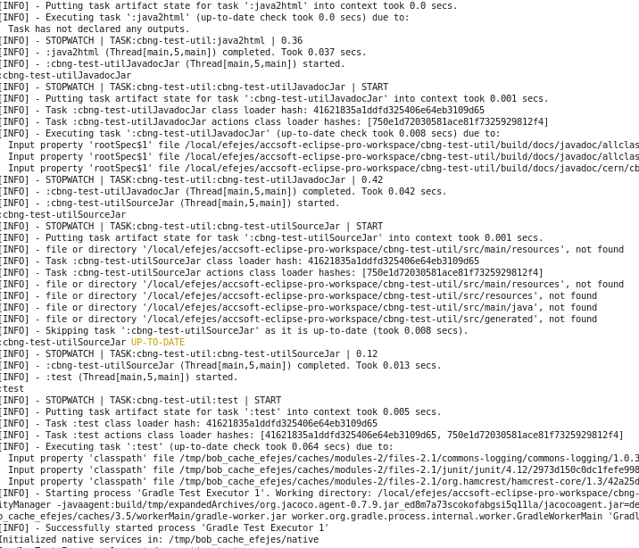
Logging
Difficult to customise
Only internal API to configure or hook into
No nice way for logging into file (as well)
Especially with different log levels

Slide 42

Logging alternative
Custom logging plugin
Uses internal API ☹
Logging into file as well
With at least info log level
Ease support
Avoid re-runs

Slide 43
Logging alternative – log summary
Cleaner error feedback
Error and warning messages summarised
---------------------------------------------------------
Summary of warnings and errors in lsa-ext-ad
---------------------------------------------------------
[WARN] - Test execution is disabled for this project. To turn it back, remove the junit.enabled=false property
BUILD SUCCESSFUL

Slide 44
Logging alternative – “What’s next” hint
What to do next in case of an error
---------------------------------------------------------
Summary of warnings and errors in accsoft-timing-app-log-analyzer
---------------------------------------------------------
:test
- Try turning off the parallel execution with the maxParallelForks=1 property in case the tests are not completely isolated
BUILD FAILED

Slide 45
Logging alternative – “What’s next” hint
… and in case of success
---------------------------------------------------------
Hints for lsa-ext-ad
---------------------------------------------------------
:release
- Artifacts: http://repo/[...]/cern/lsa/lsa-ext-ad/1.2.15
- PRO of lsa-ext-ad was updated to 1.2.15
BUILD SUCCESSFUL

Slide 46
Logging alternative – conclusion
Filtering out irrelevant noise
Collecting relevant information
Open-sourcing is planned …

Slide 47

Building Eclipse plugins
Lack of support for building Eclipse plug-ins
Wuff! Project – abandoned 2 years ago
bnd-platform – aimed at OSGi: lots of configuration
Maybe the solution in Buildship’s buildSrc will be published?

Slide 48
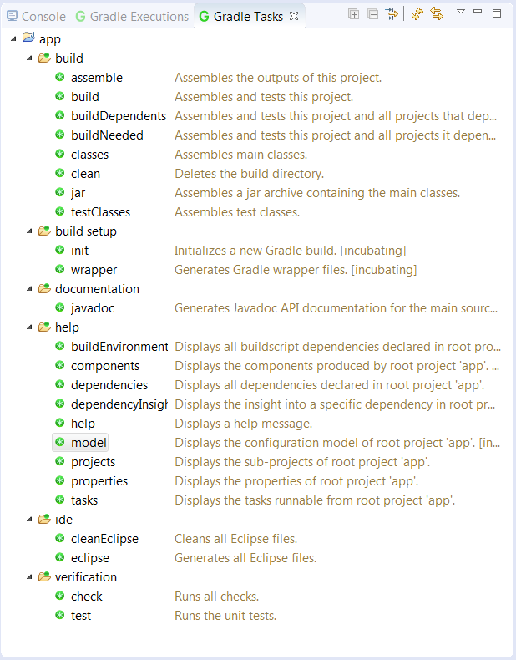

Buildship
Lacks simplicity
Dozens of unused tasks

Slide 49
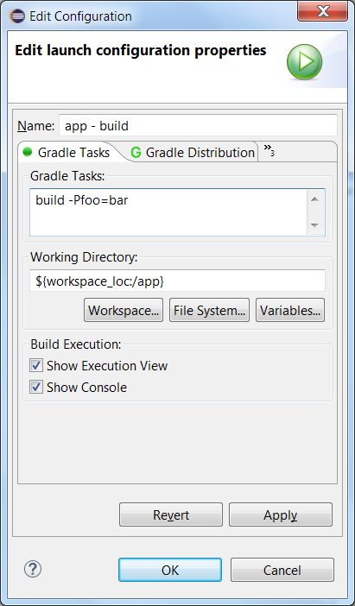
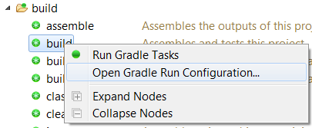
Buildship
Lacks simplicity
Dozens of unused tasks
Arguments in run configurations

Slide 50
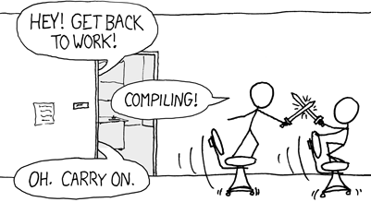
Buildship
Lacks simplicity
Dozens of unused tasks
Arguments in run configurations
Scalability issues
Having to re-configure after workspace cleaning
http://xkcd.com/303
CONFIGURING!

Slide 51
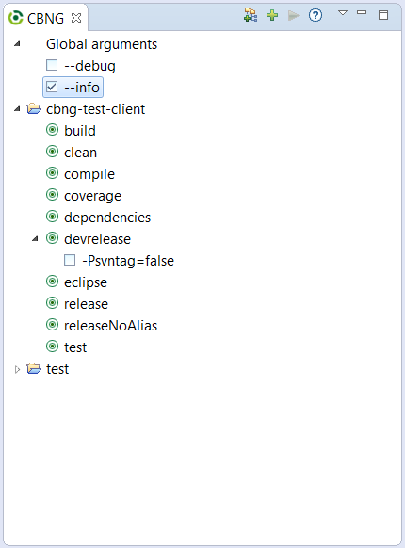
Buildship alternative
Thanks Donát ☺
Replacement using Gradle Tooling
Inspired by Ant plugin
Simplicity – static defaults
Common tasks and arguments

Slide 52
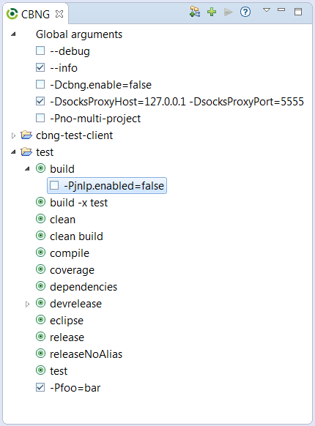
Buildship alternative
Replacement using Gradle Tooling
Inspired by Ant plugin
Simplicity – static defaults
Common tasks and arguments
Customisable
Parameterised tasks
Task combinations
Custom arguments

Slide 53

Smooth migration to Gradle
Gradle features that helped:
Dynamic task generation
POM customisation
Special dependency handling
Init scripts
Gradle can replace any build tool?
Yes, it can

